Slide 1


Electrical Power System Architecture
Ship Electrical Distribution System Design
Revision of August 23, 2026
Dr. Norbert Doerry
http://doerry.org/norbert/MarineElectricalPowerSystems/index.htm
© 2026 by Norbert Doerry
This work is licensed via: CC BY 4.0 (https://creativecommons.org/)

Slide 2
Essential Questions
What are the principal features of radial, ring, and zonal architectures? | Understand
What are the advantages and disadvantages of each of the architectures? | Understand
For what applications is each appropriate? | Understand
How does dynamic positioning influence electrical power system architecture? | Understand

Slide 3
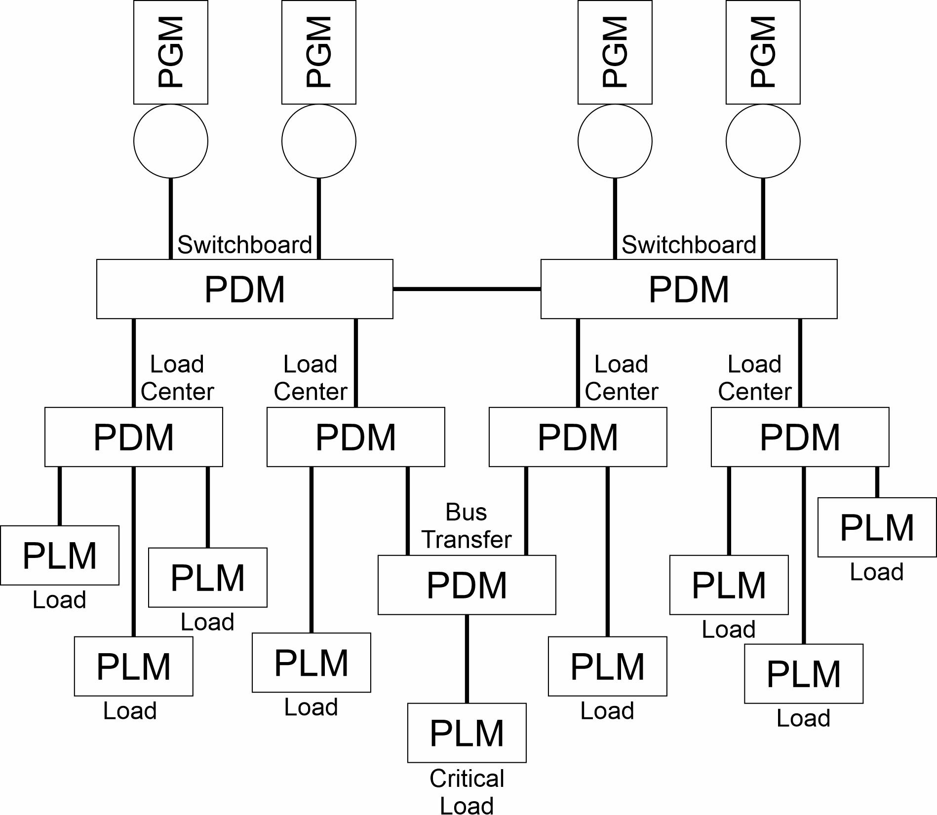
Architecture
Defines patterns for how elements of a system can connect and interact

Slide 4
Electrical power system architectural modules
Power Generation Module (PGM)
  Converts fuel (or other source of energy) into electrical power.
  Provides power to the PDM.
Power Distribution Module (PDM)
  Provides power connectivity between other modules.
Power Conversion Module (PCM)
  Converts electrical power of one type (interface standard) to another type.
Energy Storage Module (ESM)
  Stores electrical energy (charges electrically and discharges electrically).
Platform Load Module (PLM)
  User loads (can be called hotel loads or ship service loads).
Propulsion Motor Module (PMM)
  Converts electrical power into mechanical power for propelling the ship.
Power Control Module (PCON)
  Software (and possibly hardware) needed to successfully operate and maintain the electrical power system.

Slide 5
Voltage levels
Low, medium and high voltage are not universally defined to specific voltage levels.
  Discipline specific definitions.
Low voltage
  Up to 1,000 volts (either ac or dc).
  Term “low voltage” may be defined differently depending on standard.
    For example, many safety standards define low voltage as below ~40 volts.
Medium voltage (or high voltage)
  1,000 volts (either ac or dc) to ~30,000 volts.
  Virtually all shipboard electrical power systems below 15,000 volts.
  Use of term “medium voltage” or “high voltage” inconsistent among standards.
1,000 may be considered either low voltage or medium (high) voltage depending on interface standard used.

Slide 6
A.C. vs D.C. power distribution
A.C. power generation and distribution is most common
  Most loads require low voltage a.c. power.
  Transformers provide reliable voltage conversion; enabling medium voltage a.c. power generation and distribution.
Low voltage d.c. power generation and distribution becoming more prevalent
  Enables more efficient operation of diesel generator sets.
  Easier integration of energy storage.
  Possible reduction in total power conversion steps.
Medium voltage d.c. power generation and distribution is technologically limited
  Largely due to limitations in fault protection equipment.

Slide 7
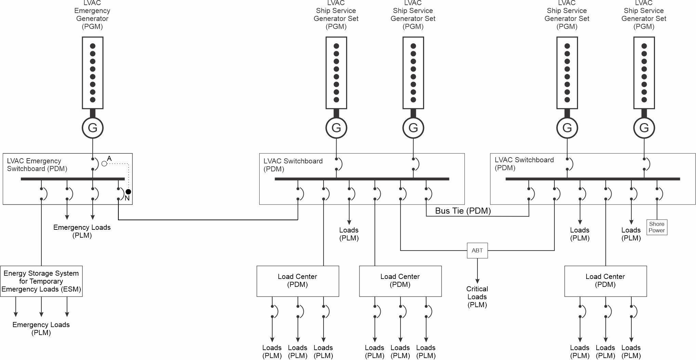
Radial architecture
Every switchboard connects to a power source
Uni-directional power flow to loads
Critical loads use bus transfer device
  ABT
  MBT
  SSABT
Loads may be anywhere on the ship
Emergency loads
  Normally powered from a ship service switchboard
  Alternate is the Emergency Generator (can only power emergency loads)
Low voltage ac radial distribution

Slide 8
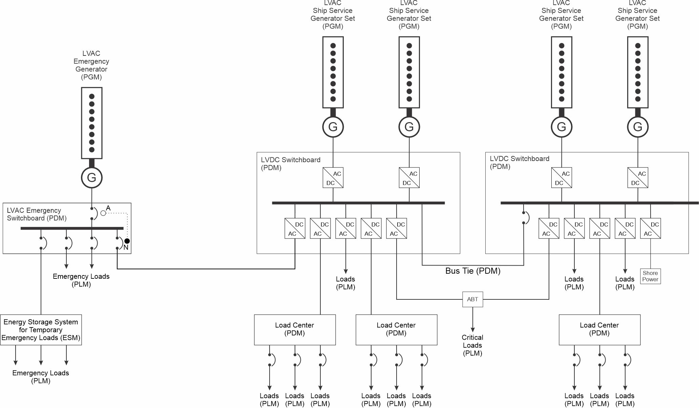
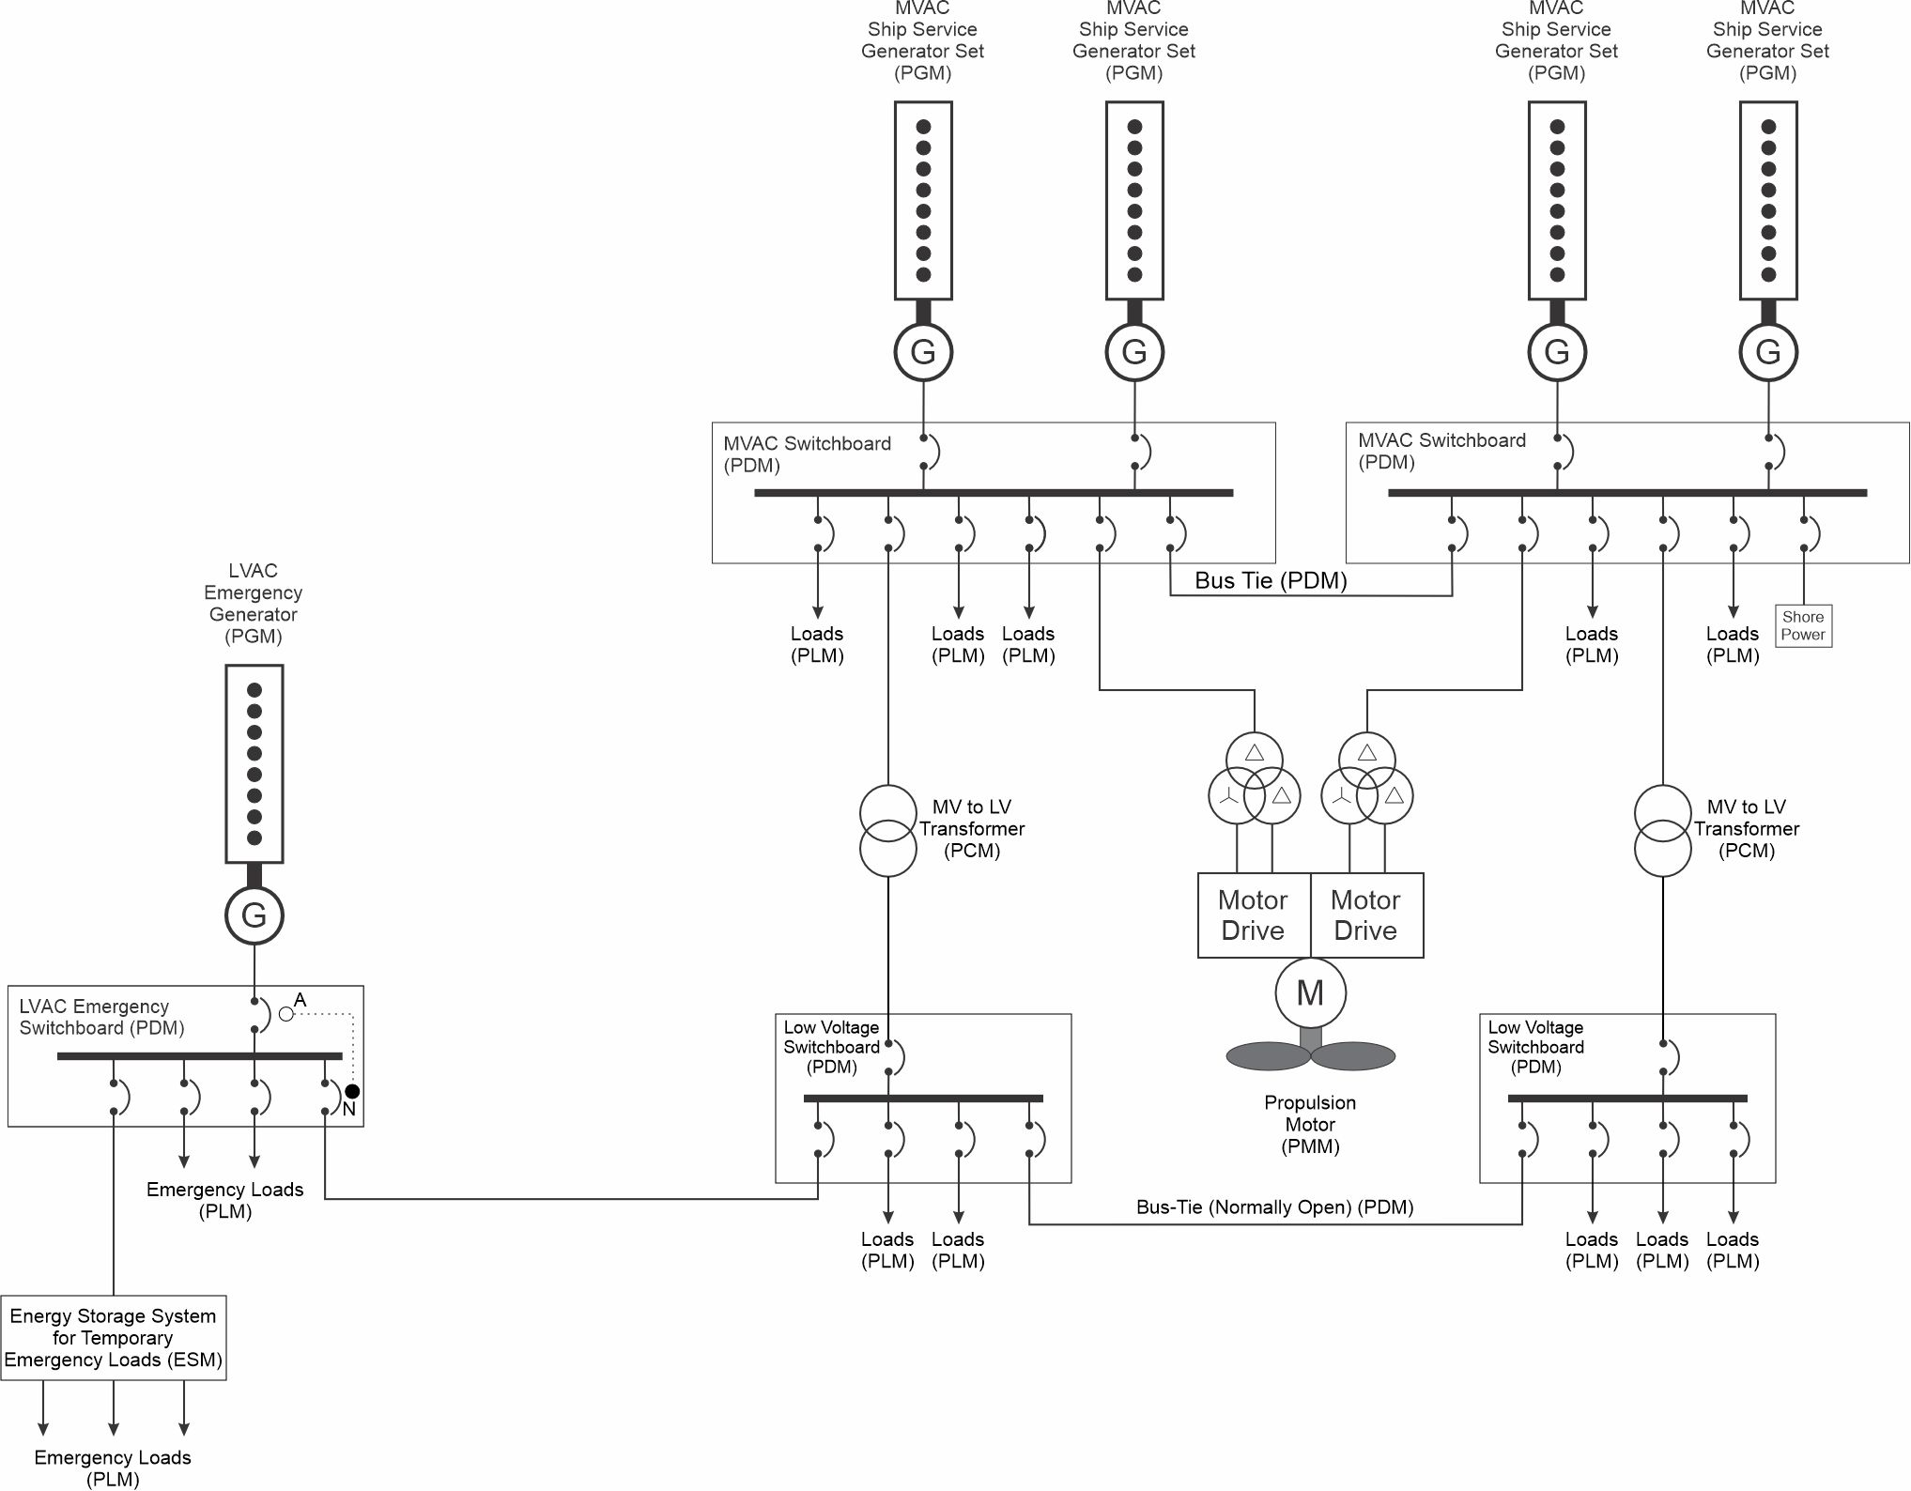
Radial Architecture (continued)
Low voltage dc radial distribution
Medium voltage ac radial distribution

Slide 9
Radial Architecture (continued)
Advantages
  Simplicity
  In many ships all ship service generator sets and switchboards in the same machinery space
    Eases watchstander effort
    Emergency generators separated
  Basis for many regulations and class rules
Disadvantages
  Long feeder cables; especially for critical loads with ABTs
  If co-located, Both main switchboards may be susceptible to common failure mode
  Many loads may not be energized when maintenance is performed on a single switchboard
Applications
  Many commercial cargo ships, offshore platforms, and passenger ships
  Naval auxiliaries
  Small naval ships

Slide 10
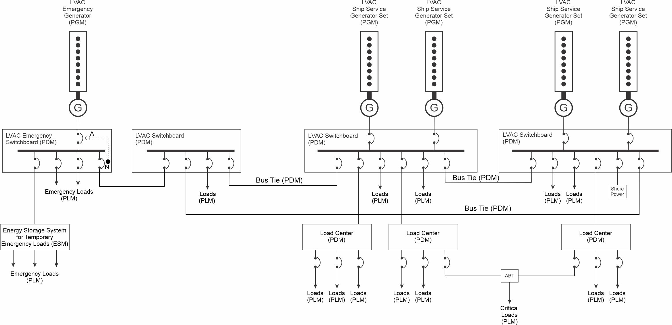
Ring architecture
Differs from radial architecture
  Not every switchboard need have an associated source
  Switchboards connected in a ring such that power connectivity is maintained with all switchboards with the loss of an arbitrary bus-tie
Normally operated for parallel plant operation with all bus-ties closed.
  Quick recovery of power to a switchboard in case of loss of an arbitrary bus-tie.
Low voltage ac ring distribution

Slide 11
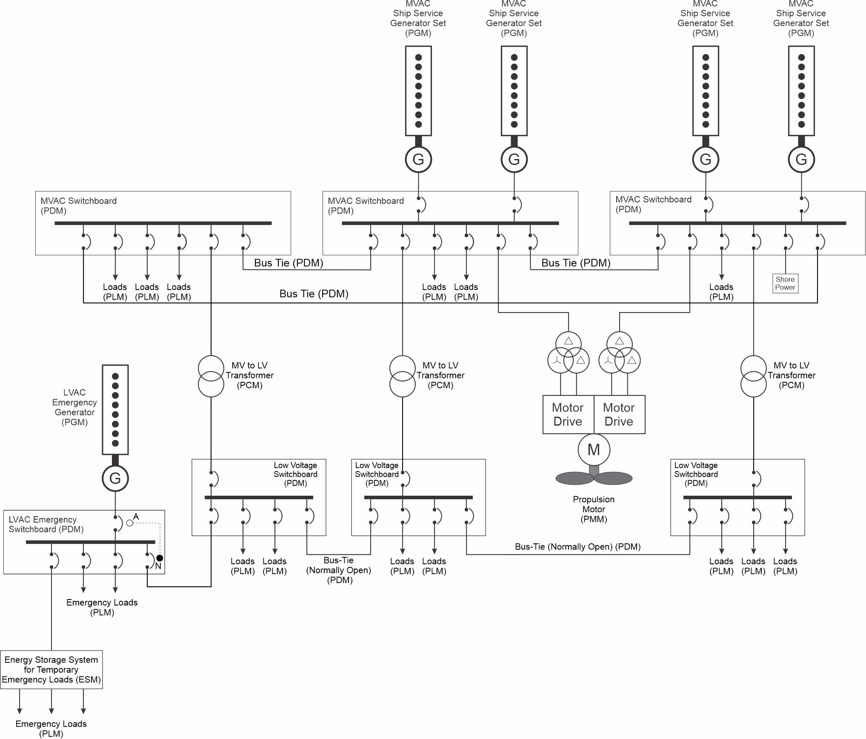
Ring Architecture (continued)
Medium voltage ac ring distribution

Slide 12
Ring Architecture (continued)
Advantage
  Improvement in reliability and survivability of the electrical power system.
  Length of feeder cables to loads may be shorter than for radial architecture.
Disadvantages
  Increased number of switchboards.
  More complicated circuit protection for ring bus where power is not unidirectional.
Applications
  Ships with many, distributed, electric loads.
  Also applicable to ships required to SOAL to be capable of safe return to port following a fire casualty or flooding of a single watertight compart.
  Ring buses found on large cruise ships, naval warships, and large high-power offshore platforms.

Slide 13
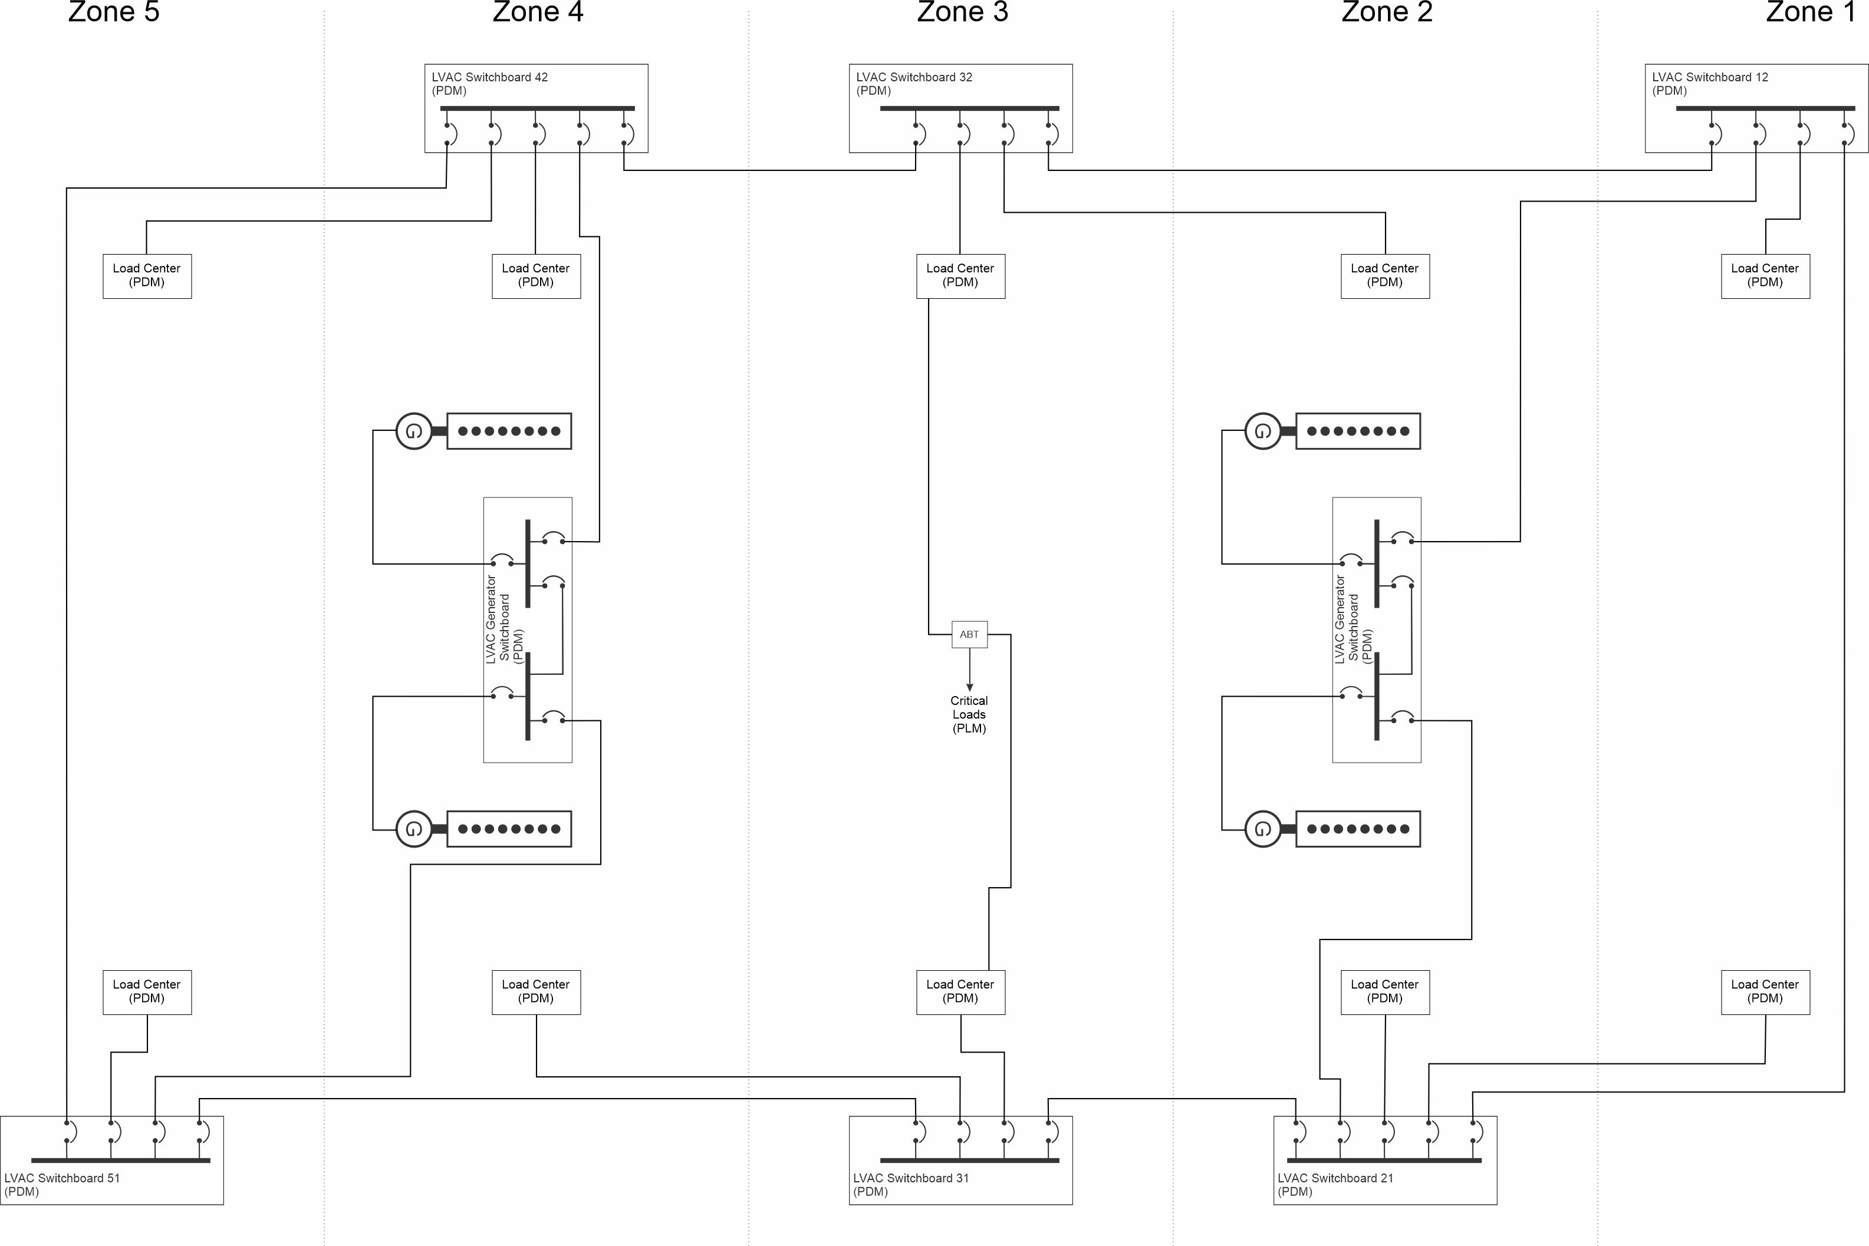
Zonal architecture
The ship is divided geographically into multiple zones.
The ring bus may be configured as a port and starboard bus.
  Each bus is segmented by switchboards that provide power to load centers, possibly via a PCM. A zone is not required to have a switchboard;
  a load center may be powered by switchboard in another zone.
Sources are typically, but not always, connected to a generator switchboard that may be configured to connect to either the port or starboard bus.
The port and starboard buses, if provided, may be interconnected in several places to enable parallel operation.
  Typically, split plant operation is used such that the port and starboard buses operate independently.
All loads are powered by load centers or switchboards within the zone. Critical loads typically have a normal connection to a load center or switchboard powered from one bus (port or starboard), and an alternate connection to a load center or switchboard powered by the other bus.
The power system is designed to provide zonal survivability.
Low voltage ac zonal distribution

Slide 14
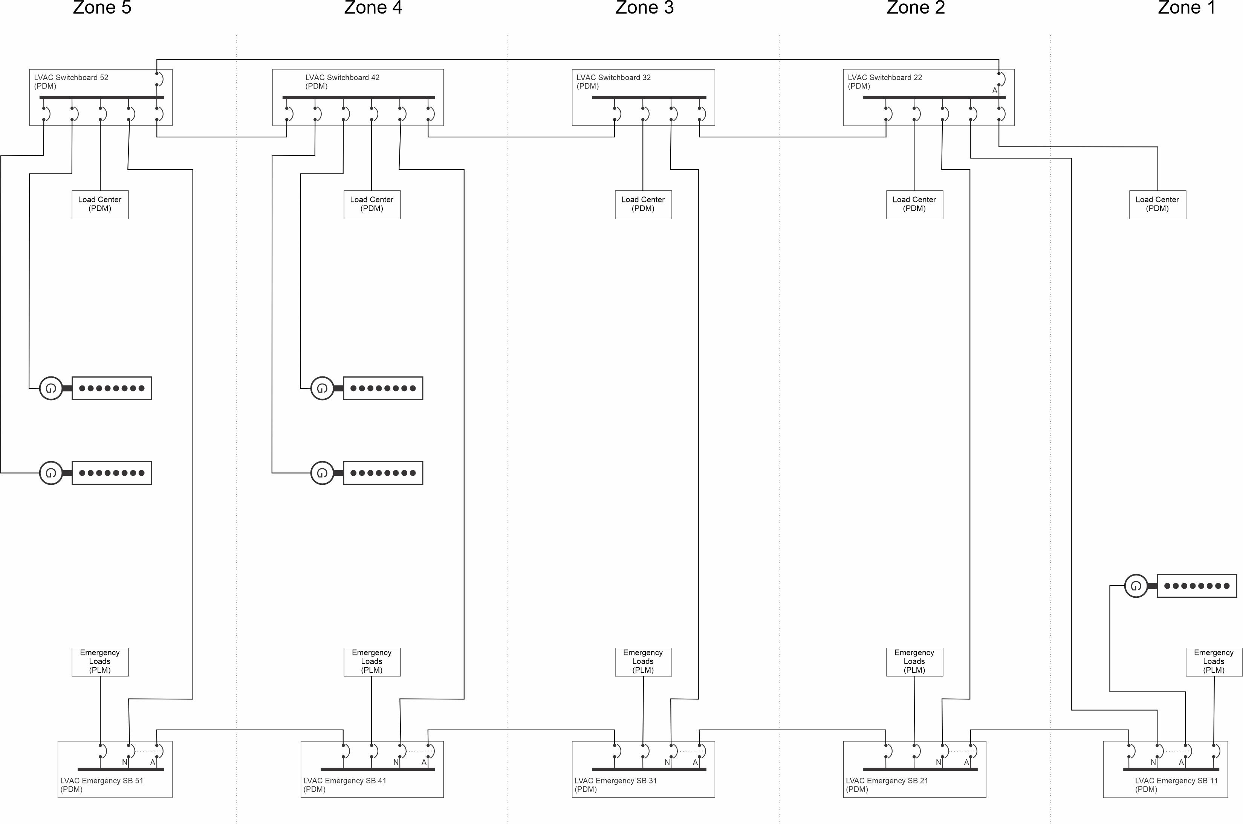
Zonal Architecture (continue)
Low voltage ac zonal distribution with zonal emergency bus

Slide 15
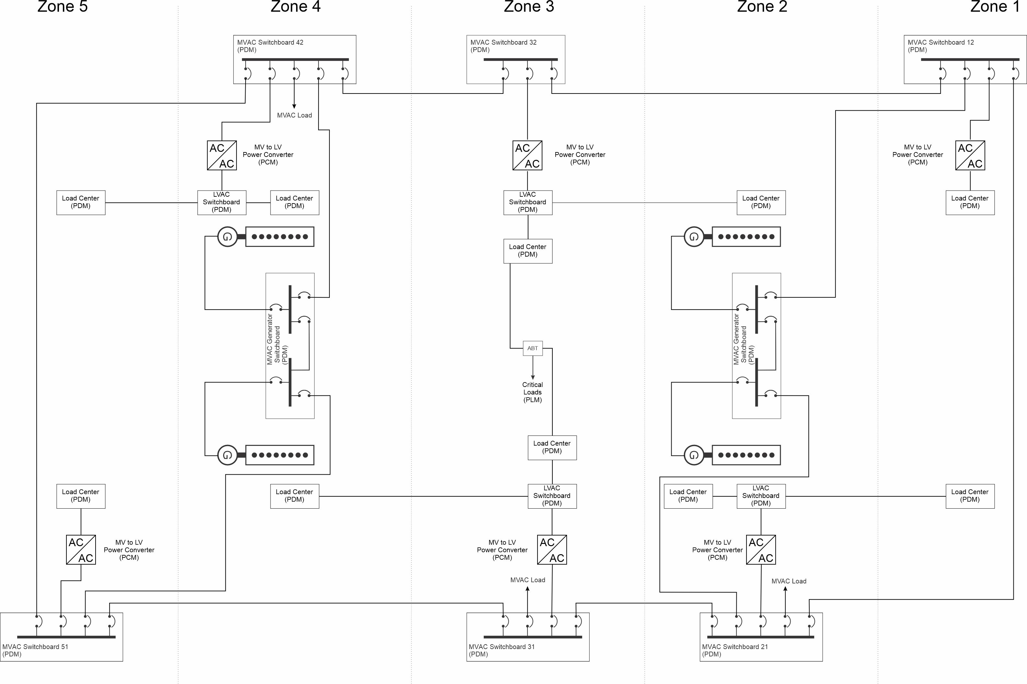
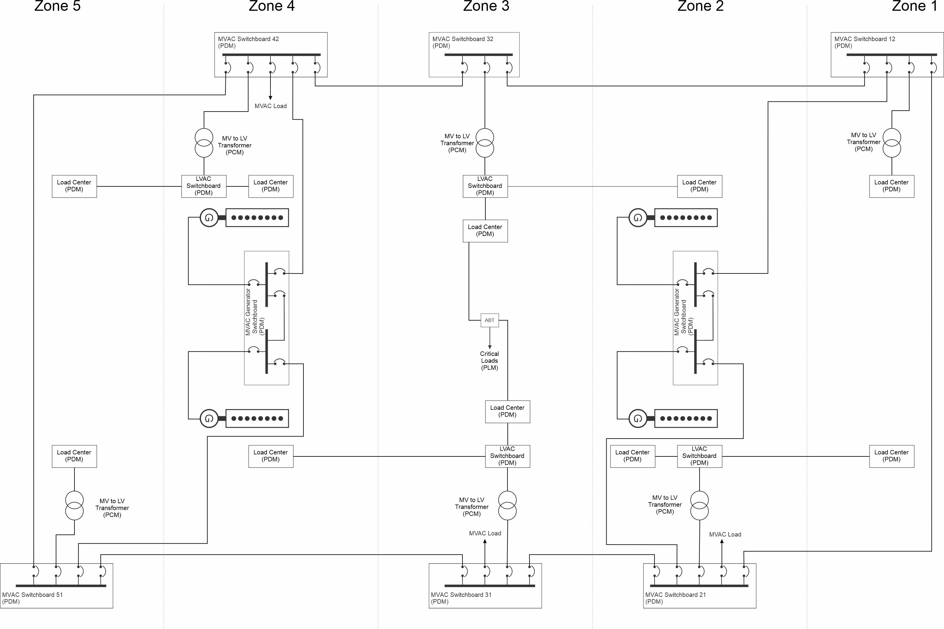
Zonal Architecture (continued)
Medium voltage ac zonal distribution
with power electronic converters
Medium voltage ac zonal distribution

Slide 16
Zonal Architecture (continued)
Advantages
  For mission critical loads, normal and alternate feeder cables are typically shorter since they do not cross zone-boundaries.
  Enables zonal survivability which can ensure a level of survivability by design rather than the traditional method of proposing a solution and then confirming (or not) survivability by analysis.
  Simplifies operational awareness since unexpected behavior should be isolated to only the damaged zones. Undamaged zones should not experience a degradation of service to mission critical loads.
  Prevents cascading faults due to misalignment of individual distributed system zone boundaries.
  Enables zone designs to be re-used across ship design applications; for the most part, modifications to the electrical system are only required in the zones where modifications to other systems are made.
  Enables designing power systems so that the power systems within a zone can be energized prior to the ship zone being integrated with the remainder of the ship; thereby reducing the amount of temporary services required for lighting, ventilation, and electric power.
Disadvantages
  A possible increase in the total number of switchboards as compared to radial and ring bus architectures.
  In common with ring buses, circuit protection for a zonal distribution system may require a more complicated design due to the lack of unidirectional power flow within the bus-ties. Typically, differential protection, or directional protection is employed instead of simple time vs fault current curves.
Applications
  Naval warships
  Complex commercial ships
  Ships required to accommodate safe return to port capabilities

Slide 17
Dynamic positioning
IMO defines 3 classes of dynamic positioning; ABS has associated classification notations for these plus one additional:
    DPS-0 For vessels which are fitted with centralized manual position control and automatic heading control system to maintain the position and heading (Station Keeping) under the specified maximum environmental conditions.
    DPS-1 For vessels which are fitted with a dynamic positioning system which is capable of automatically maintaining the position and heading (Station Keeping) of the vessel under specified maximum environmental conditions having a manual position control system.
    DPS-2 For vessels which are fitted with a dynamic positioning system which is capable of automatically maintaining the position and heading (Station Keeping) of the vessel within a specified operating envelope under specified maximum environmental conditions during and following any single fault, excluding a loss of compartment or compartments.
    DPS-3 For vessels which are fitted with a dynamic positioning system which is capable of automatically maintaining the position and heading (Station Keeping) of the vessel within a specified operating envelope under specified maximum environmental conditions during and following any single fault, including complete loss of a compartment due to fire or flood.
Functional
Redundancy
Physical
Separation
ABS Guide for Dynamic Positioning Systems

